Slide 1
ORBITAL-FREE DESCRIPTION OF COULOMB SYSTEMS
B. Godo and A. Nagy
Department of Theoretical Physics
University of Debrecen
Debrecen, Hungary

Slide 2
OUTLINE
Introduction
Descriptors of Coulomb systems
Construction of 'generalized densities' in the Kohn-Sham system
Diferential equation for the 'generalized densities'
'Generalized densities' as descriptors of Coulomb systems
Pauli potential for the 'generalized densities'
Numerical method of the solution

Slide 3
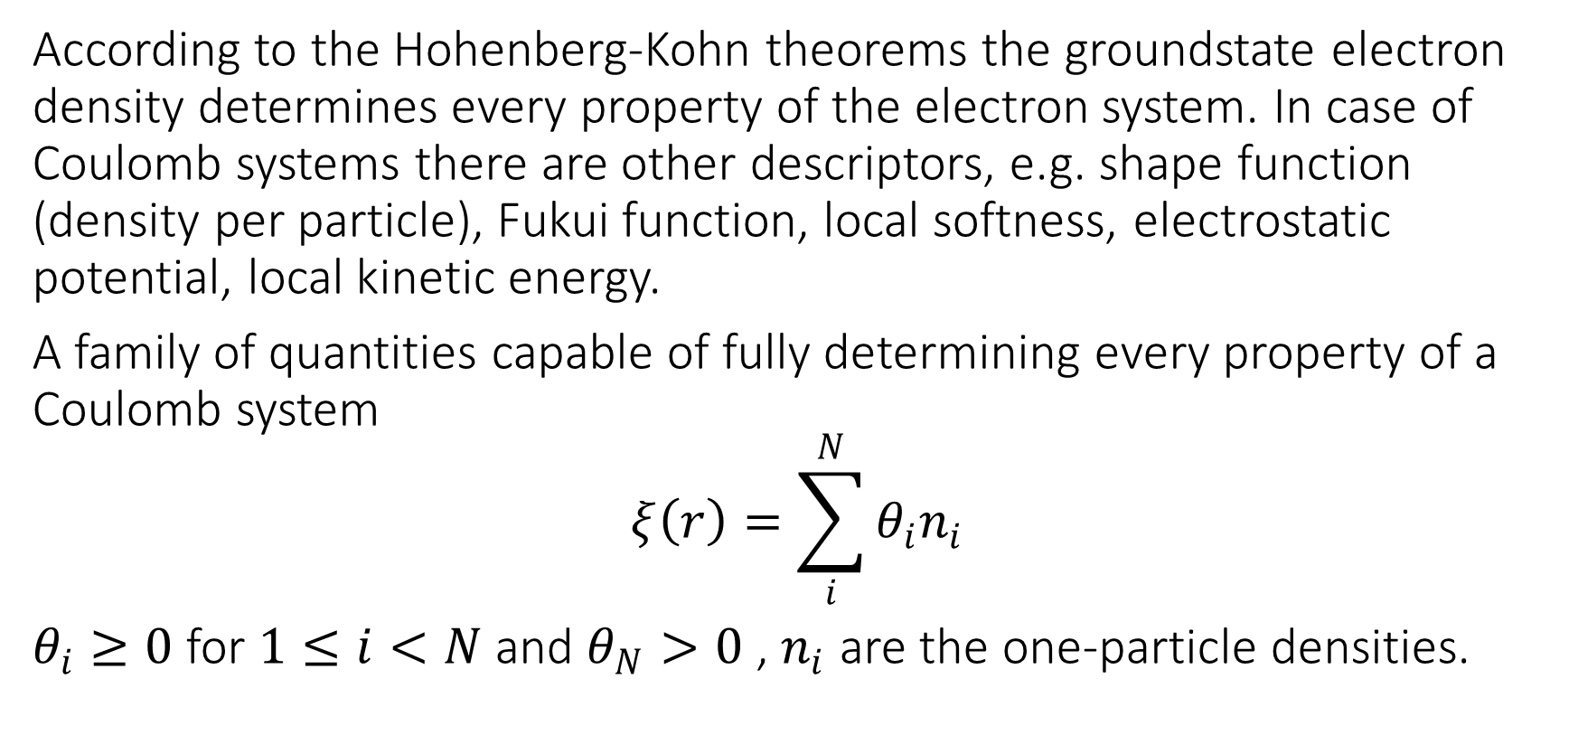
Alternative descriptors of Coulomb systems
According to the Hohenberg-Kohn theorems the groundstate electron density determines every property of the electron system. In case of Coulomb systems there are other descriptors, e.g. shape function (density per particle), Fukui function, local softness, electrostatic potential, local kinetic energy.
A family of quantities capable of fully determining every property of a Coulomb system
$$ξ\left(r\right)=\sum_{i}^{N}{θ_{i}n_{i}}$$
$θ_{i}≥0$ for $1≤i<N$ and $θ_{N}>0$ , $n_{i}$ are the one-particle densities.

Slide 4
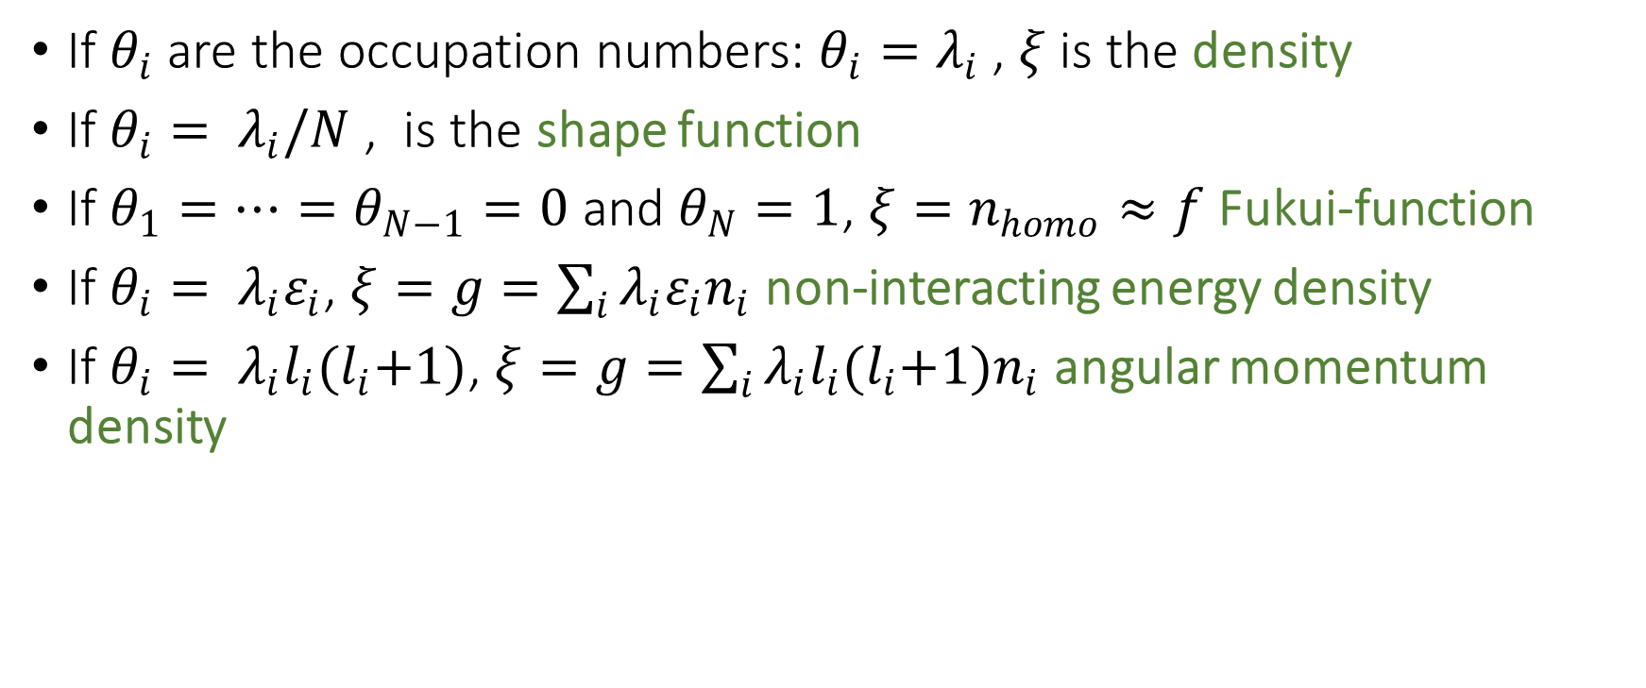
Examples
If $θ_{i}$ are the occupation numbers: $θ_{i}=λ_{i}$ , $ξ$ is the density
If $θ_{i}= λ_{i}/N$ , is the shape function
If $θ_{1}=…=θ_{N−1}=0$ and $θ_{N}=1$, $ξ=n_{homo}≈f$ Fukui-function
If $θ_{i}= λ_{i}ε_{i}$, $ξ=g=\sum_{i}{λ_{i}ε_{i}n_{i}}$ non-interacting energy density
If $θ_{i}= λ_{i}l_{i}{(l}_{i}+1)$, $ξ=g=\sum_{i}{λ_{i}l_{i}{(l}_{i}+1)n_{i}}$ angular momentum density

Slide 5

Coulomb Hamiltonian
$$\hat{H}=\hat{T}+\hat{V_{ee}}+\sum_{i=1}^{N}{v(r_{i})}$$
kinetic energy:
$$\hat{T}=\sum_{j=1}^{N}{(−\frac{1}{2}∇_{j}^{2})}$$
electron-electron energy:
$$\hat{V_{ee}}=\sum_{i=1}^{N−1}{\sum_{j=i+1}^{N}{\frac{1}{\left|r_{i}−r_{j}\right|}}}$$
external potential:
$$v\left(r\right)=−\sum_{β=1}^{M}{\frac{Z_{β}}{\left|r−R_{β}\right|}}$$

Slide 6
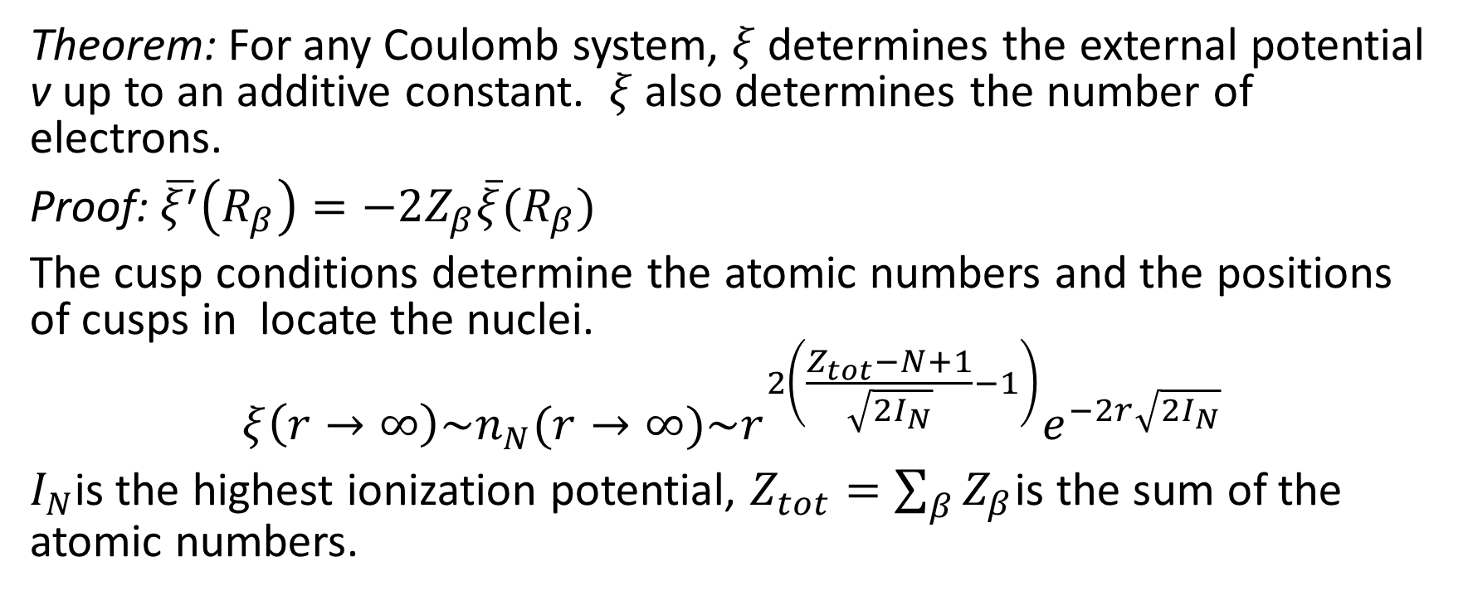
Alternative descriptors of Coulomb systems
Theorem: For any Coulomb system, $ξ$ determines the external potential v up to an additive constant. $ξ$ also determines the number of electrons.
Proof: $\overline{ξ^{′}}\left(R_{β}\right)=−2Z_{β}\overline{ξ}(R_{β})$
The cusp conditions determine the atomic numbers and the positions of cusps in locate the nuclei.
$$ξ\left(r→∞\right)\sim n_{N}(r→∞)\sim r^{2\left(\frac{Z_{tot}−N+1}{\sqrt{2I_{N}}}−1\right)}e^{−2r\sqrt{2I_{N}}}$$
$I_{N}$is the highest ionization potential, $Z_{tot}=\sum_{β}{Z_{β}}$is the sum of the atomic numbers.

Slide 7
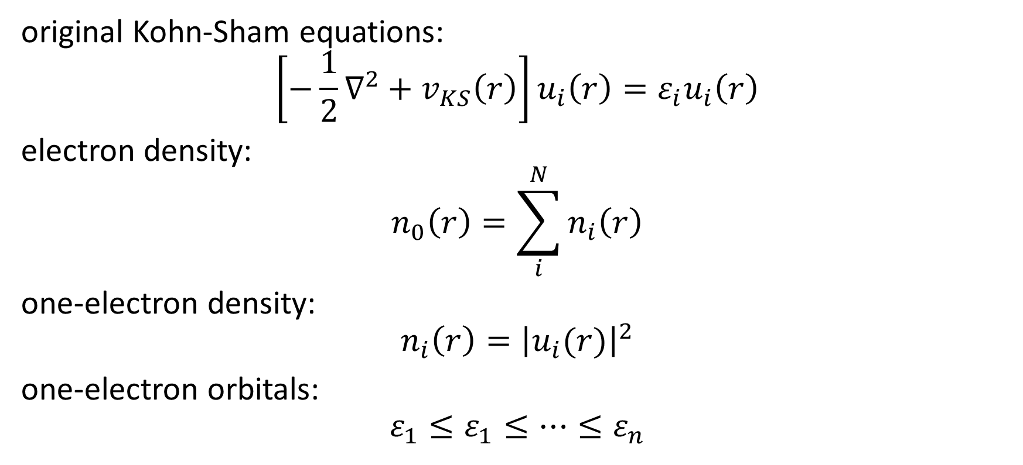
The original Kohn-Sham system
original Kohn-Sham equations:
$$\left[−\frac{1}{2}∇^{2}+v_{KS}\left(r\right)\right]u_{i}\left(r\right)=ε_{i}u_{i}\left(r\right)$$
electron density:
$$n_{0}\left(r\right)=\sum_{i}^{N}{n_{i}\left(r\right)}$$
one-electron density:
$$n_{i}\left(r\right)={\left|u_{i}(r)\right|}^{2}$$
one-electron orbitals:
$$ε_{1}≤ε_{1}≤…≤ε_{n}$$

Slide 8
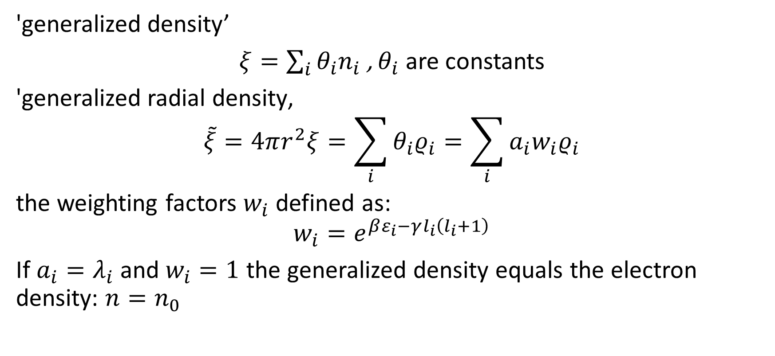
Construction of 'generalized densities' in the Kohn-Sham system
'generalized density’
$ξ=\sum_{i}{θ_{i}n_{i}}$ , $θ_{i}$ are constants
'generalized radial density‚
$$\tilde{ξ}=4πr^{2}ξ=\sum_{i}{θ_{i}ρ_{i}}=\sum_{i}{a_{i}w_{i}ρ_{i}}$$
the weighting factors $w_{i}$ defined as:
$$w_{i}=e^{βε_{i}−γl_{i}\left(l_{i}+1\right)}$$
If $a_{i}=λ_{i}$ and $w_{i}=1$ the generalized density equals the electron density: $n=n_{0}$

Slide 9
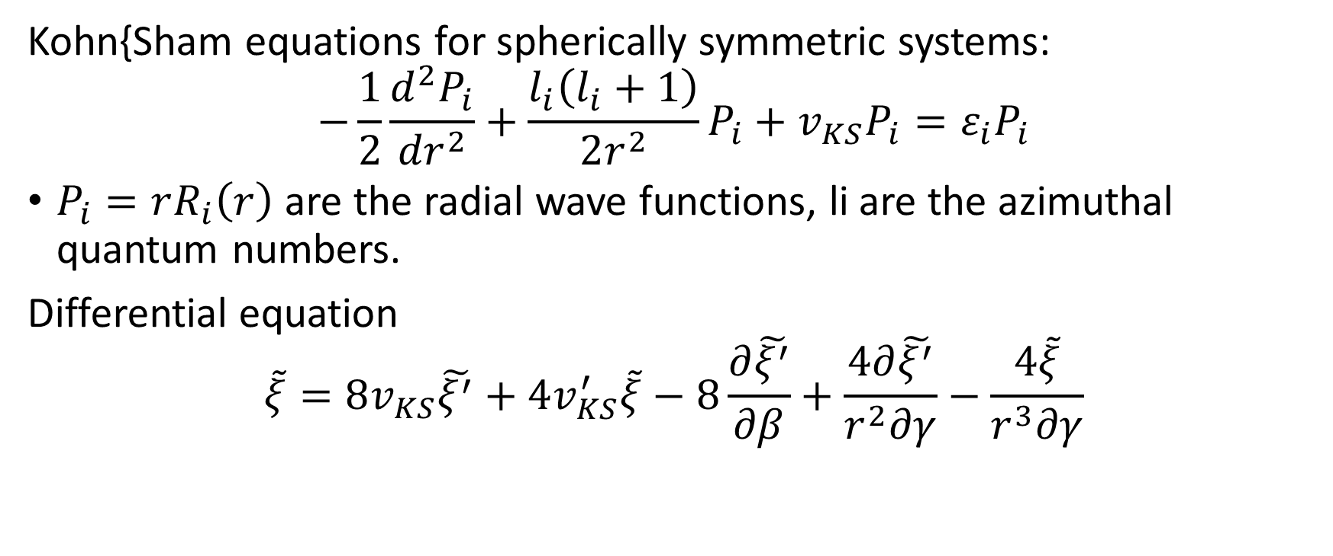
Differential equation for the 'generalized densities'
Kohn{Sham equations for spherically symmetric systems:
$$−\frac{1}{2}\frac{d^{2}P_{i}}{{dr}^{2}}+\frac{l_{i}\left(l_{i}+1\right)}{2r^{2}}P_{i}+v_{KS}P_{i}=ε_{i}P_{i}$$
$P_{i}=rR_{i}\left(r\right)$ are the radial wave functions, li are the azimuthal quantum numbers.
Differential equation
$$\tilde{ξ}=8v_{KS}\tilde{ξ^{′}}+4v_{KS}^{′}\tilde{ξ}−8\frac{∂\tilde{ξ^{′}}}{∂β}+\frac{4∂\tilde{ξ^{′}}}{r^{2}∂γ}−\frac{4\tilde{ξ}}{r^{3}∂γ}$$

Slide 10
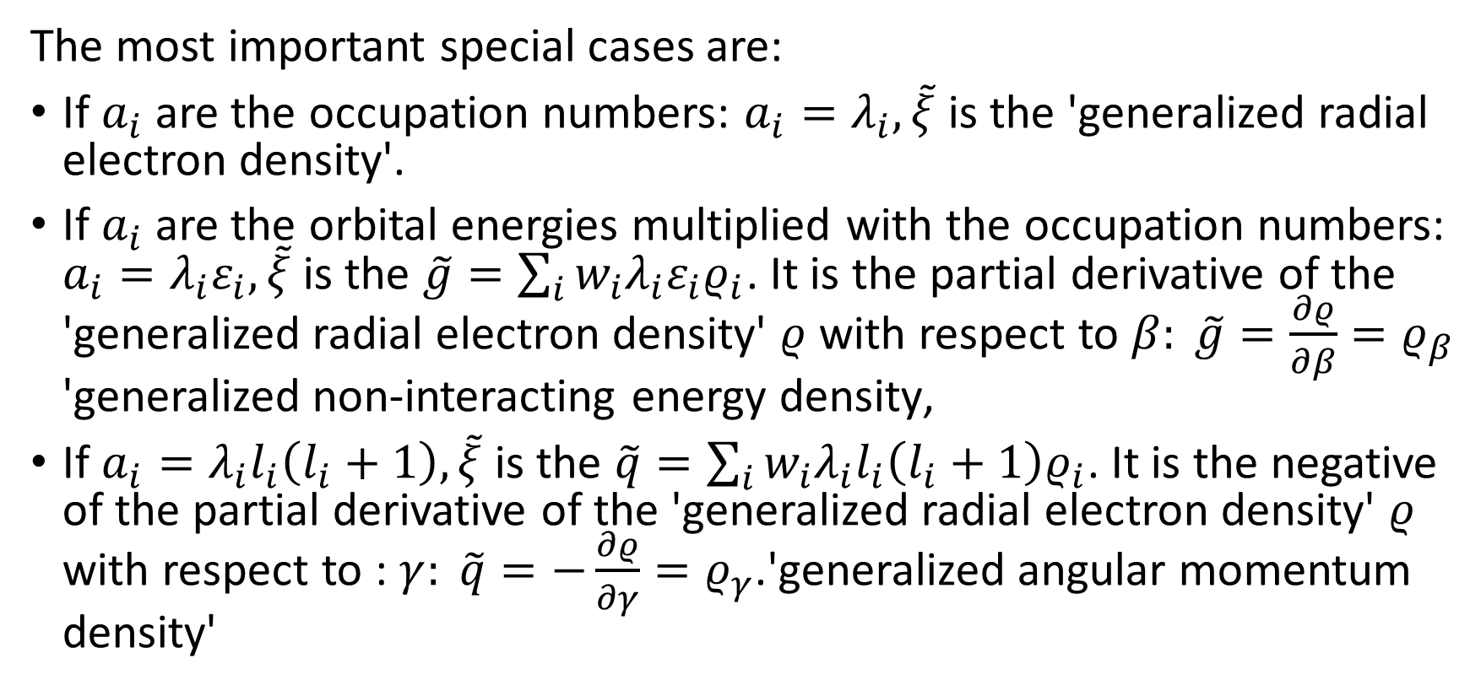
'Generalized densities' as descriptors of Coulomb systems
The most important special cases are:
If $a_{i}$ are the occupation numbers: $a_{i}=λ_{i}, \tilde{ξ}$ is the 'generalized radial electron density'.
If $a_{i}$ are the orbital energies multiplied with the occupation numbers: $a_{i}=λ_{i}ε_{i}, \tilde{ξ}$is the $\tilde{g}=\sum_{i}{w_{i}λ_{i}ε_{i}ρ_{i}}$. It is the partial derivative of the 'generalized radial electron density' $ρ$ with respect to $β: \tilde{g}=\frac{∂ρ}{∂β}=ρ_{β}$ 'generalized non-interacting energy density‚
If $a_{i}=λ_{i}l_{i}\left(l_{i}+1\right), \tilde{ξ}$ is the $\tilde{q}=\sum_{i}{w_{i}λ_{i}l_{i}\left(l_{i}+1\right)ρ_{i}}$. It is the negative of the partial derivative of the 'generalized radial electron density' $ρ$ with respect to : $γ: \tilde{q}=−\frac{∂ρ}{∂γ}=ρ_{γ}$.'generalized angular momentum density'

Slide 11
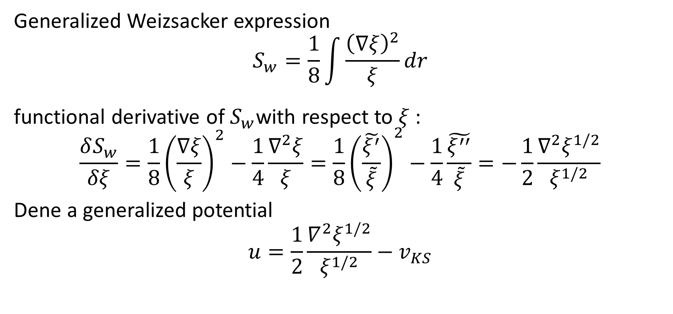
Euler equation for the 'generalized densities'
Generalized Weizsacker expression
$$S_{w}=\frac{1}{8}\int{\frac{{\left(∇ξ\right)}^{2}}{ξ}dr}$$
functional derivative of $S_{w}$with respect to $ξ$ :
$$\frac{δS_{w}}{δξ}=\frac{1}{8}{\left(\frac{∇ξ}{ξ}\right)}^{2}−\frac{1}{4}\frac{∇^{2}ξ}{ξ}=\frac{1}{8}{\left(\frac{\tilde{ξ^{′}}}{\tilde{ξ}}\right)}^{2}−\frac{1}{4}\frac{\tilde{ξ^{′′}}}{\tilde{ξ}}=−\frac{1}{2}\frac{∇^{2}ξ^{1/2}}{ξ^{1/2}}$$
Dene a generalized potential
$$u=\frac{1}{2}\frac{∇^{2}ξ^{1/2}}{ξ^{1/2}}−v_{KS}$$

Slide 12

Euler equation for the 'generalized densities'
Kohn-Sham potential
$$v_{KS}=−\frac{1}{8}{\left(\frac{\tilde{ξ^{′}}}{\tilde{ξ}}\right)}^{2}+\frac{1}{4}\frac{\tilde{ξ^{′′}}}{\tilde{ξ}} −u$$
Dierential equation for $\tilde{ξ}:$
$$\frac{1}{2}\tilde{ξ}u^{′}+\tilde{ξ^{′}}u=F$$
$$F=−\frac{∂\tilde{ξ^{′}}}{∂β}−\frac{∂\tilde{ξ^{′}}}{{2r}^{2}∂γ}−\frac{\tilde{∂ξ}}{{2r}^{3}∂γ}$$

Slide 13
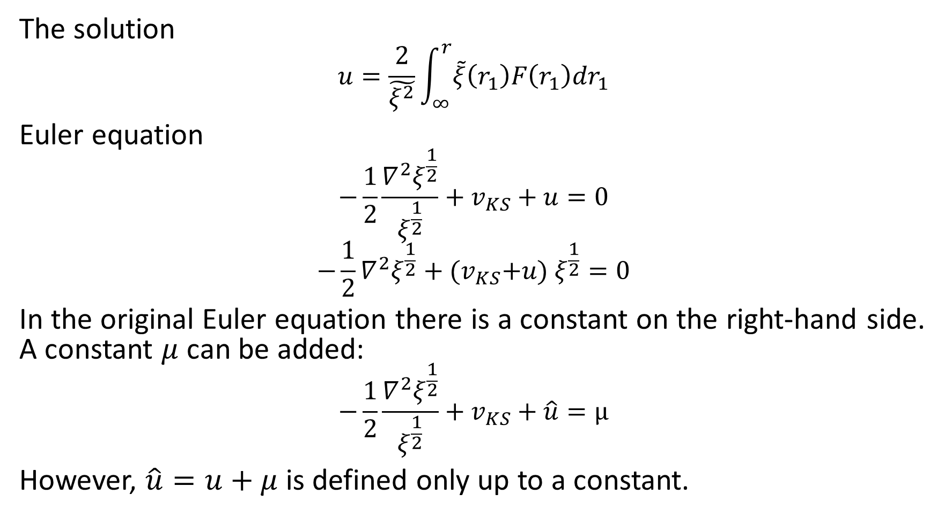
Euler equation for the 'generalized densities'
The solution
$$u=\frac{2}{\tilde{ξ^{2}}}\int_{∞}^{r}{\tilde{ξ}\left(r_{1}\right)F\left(r_{1}\right)dr_{1}}$$
Euler equation
$$−\frac{1}{2}\frac{∇^{2}ξ^{\frac{1}{2}}}{ξ^{\frac{1}{2}}}+v_{KS}+u=0$$
$$−\frac{1}{2}∇^{2}ξ^{\frac{1}{2}}+{(v}_{KS}+u) ξ^{\frac{1}{2}}=0$$
In the original Euler equation there is a constant on the right-hand side. A constant $μ$ can be added:
$$−\frac{1}{2}\frac{∇^{2}ξ^{\frac{1}{2}}}{ξ^{\frac{1}{2}}}+v_{KS}+\hat{u}=μ$$
However, $\hat{u}=u+μ$ is defined only up to a constant.

Slide 14

Euler equation for the generalized radial density
Euler equation
$$−\frac{1}{2}\frac{d^{2}}{dr^{2}}ρ^{\frac{1}{2}}+{(v}_{KS}+u) ρ^{\frac{1}{2}}=0$$
Pauli potential for the generalized radial density
$$u=\frac{2}{ρ^{2}}\int_{∞}^{r}{ρ\left(r_{1}\right)F\left(r_{1}\right)dr_{1}}$$

Slide 15
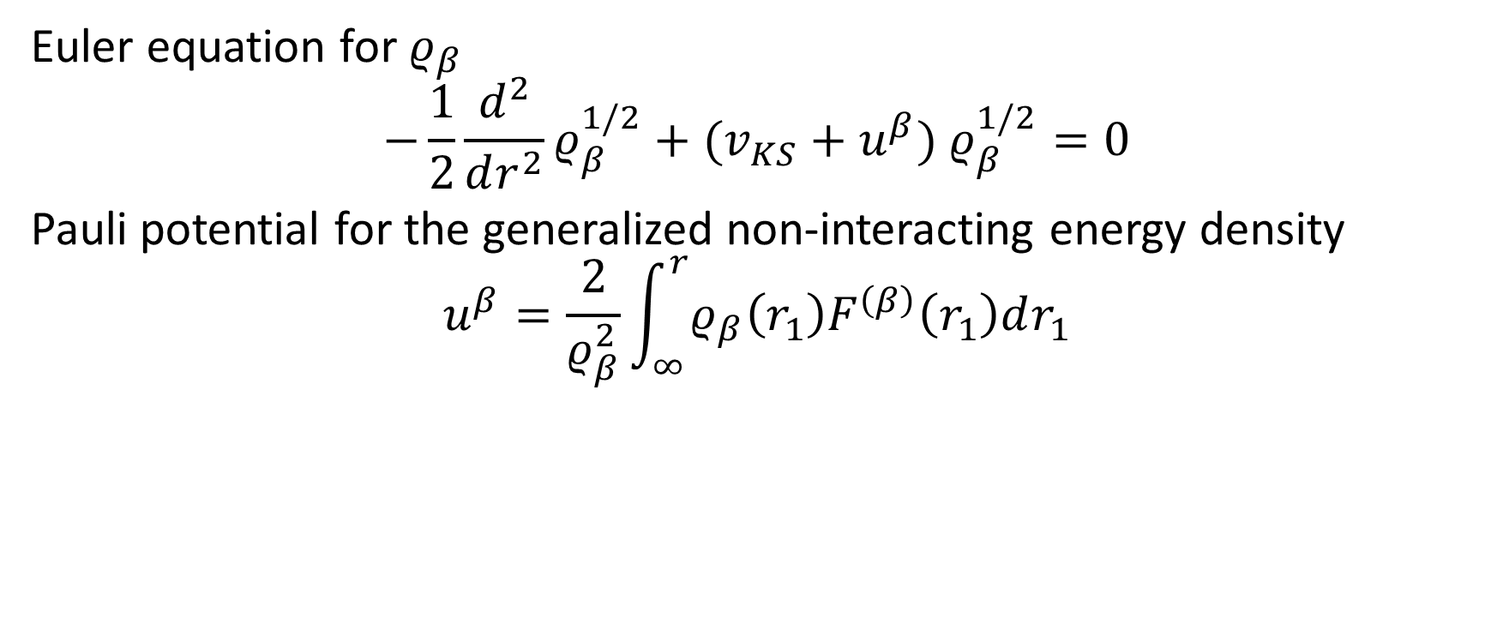
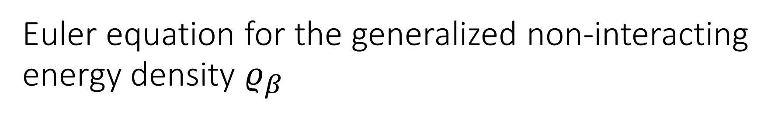
Euler equation for the generalized non-interacting energy density $ρ_{β}$
Euler equation for $ρ_{β}$
$$−\frac{1}{2}\frac{d^{2}}{dr^{2}}ρ_{β}^{1/2}+(v_{KS}+u^{β}) ρ_{β}^{1/2}=0$$
Pauli potential for the generalized non-interacting energy density
$$u^{β}=\frac{2}{ρ_{β}^{2}}\int_{∞}^{r}{ρ_{β}\left(r_{1}\right)F^{\left(β\right)}\left(r_{1}\right)dr_{1}}$$

Slide 16
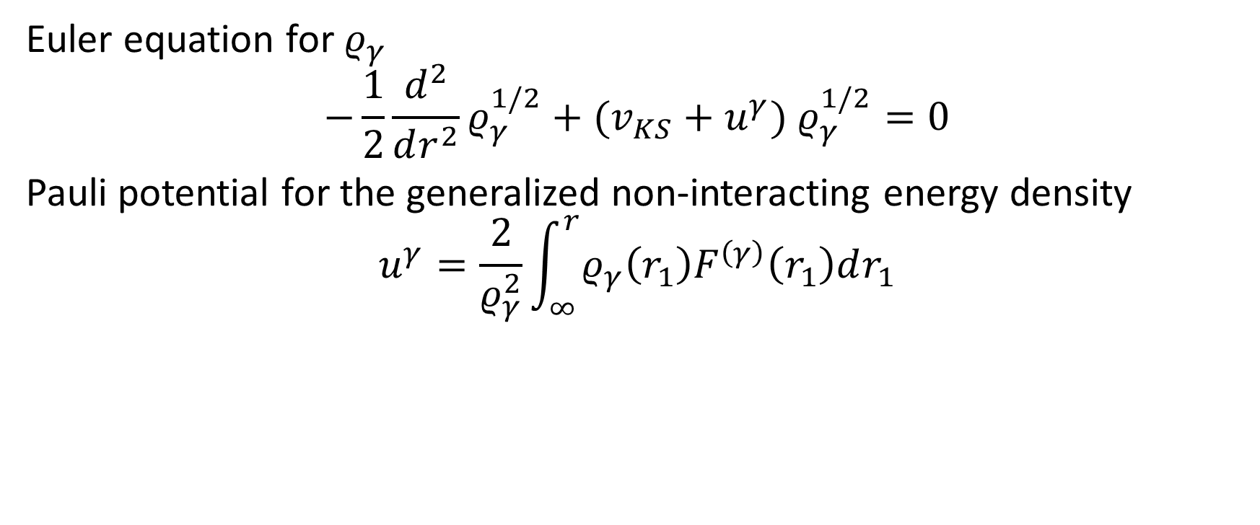
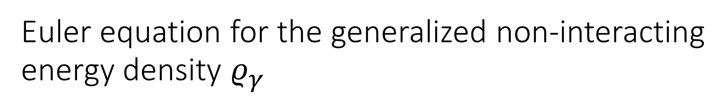
Euler equation for the generalized non-interacting energy density $ρ_{γ}$
Euler equation for $ρ_{γ}$
$$−\frac{1}{2}\frac{d^{2}}{dr^{2}}ρ_{γ}^{1/2}+(v_{KS}+u^{γ}) ρ_{γ}^{1/2}=0$$
Pauli potential for the generalized non-interacting energy density
$$u^{γ}=\frac{2}{ρ_{γ}^{2}}\int_{∞}^{r}{ρ_{γ}\left(r_{1}\right)F^{\left(γ\right)}\left(r_{1}\right)dr_{1}}$$

Slide 17
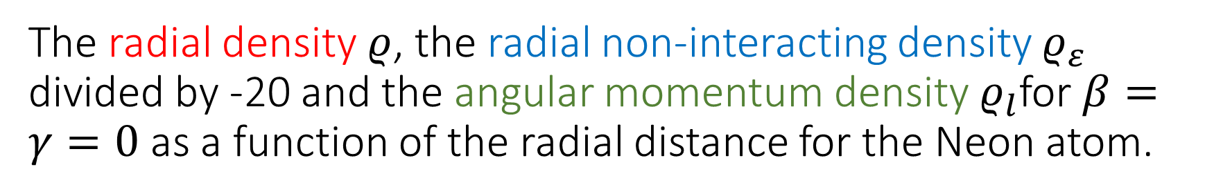
The radial density $ρ$, the radial non-interacting density $ρ_{ε}$ divided by -20 and the angular momentum density $ρ_{l}$for $β=γ=0$ as a function of the radial distance for the Neon atom.

Slide 18
Solution of the orbital-free problem for the density
ASCAM VII
Talk of Henrik Levämäki: Highly accurate orbital-free density functional theory calculations for Beryllium
H. Levämäki - A. Nagy - K. Kokko - L. Vitos: Alternative to the Kohn-Sham equations: The Pauli potential differential equation, Phys. Rev. A 92 (2015) 062502.

Slide 19
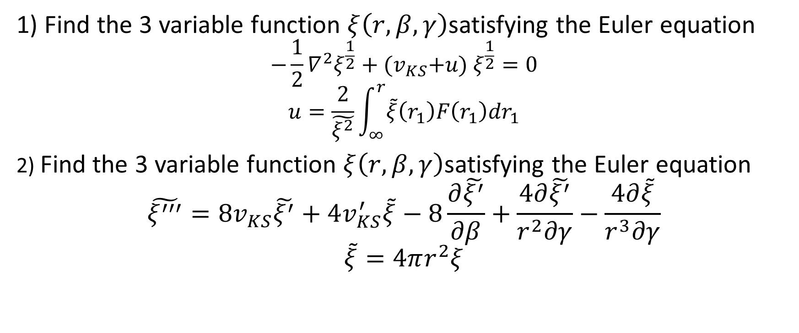
Solution of the orbital-free problem
1) Find the 3 variable function $ξ\left(r,β,γ\right)$satisfying the Euler equation
$$−\frac{1}{2}∇^{2}ξ^{\frac{1}{2}}+{(v}_{KS}+u) ξ^{\frac{1}{2}}=0$$
$$u=\frac{2}{\tilde{ξ^{2}}}\int_{∞}^{r}{\tilde{ξ}\left(r_{1}\right)F\left(r_{1}\right)dr_{1}}$$
2) Find the 3 variable function $ξ\left(r,β,γ\right)$satisfying the Euler equation
$$\tilde{ξ^{′′′}}=8v_{KS}\tilde{ξ^{′}}+4v_{KS}^{′}\tilde{ξ}−8\frac{∂\tilde{ξ^{′}}}{∂β}+\frac{4∂\tilde{ξ^{′}}}{r^{2}∂γ}−\frac{4∂\tilde{ξ}}{r^{3}∂γ}$$
$$\tilde{ξ}=4πr^{2}ξ$$

Slide 20
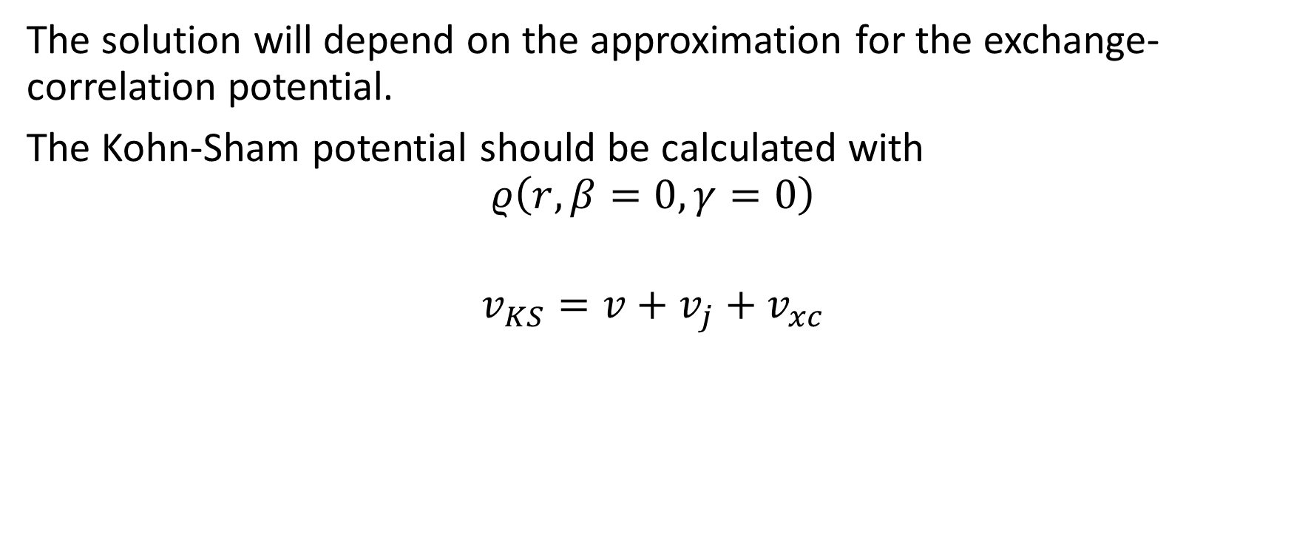
Solution of the orbital-free problem
The solution will depend on the approximation for the exchange-correlation potential.
The Kohn-Sham potential should be calculated with
$$ρ\left(r,β=0,γ=0\right)$$
$$v_{KS}=v+v_{j}+v_{xc}$$

Slide 21
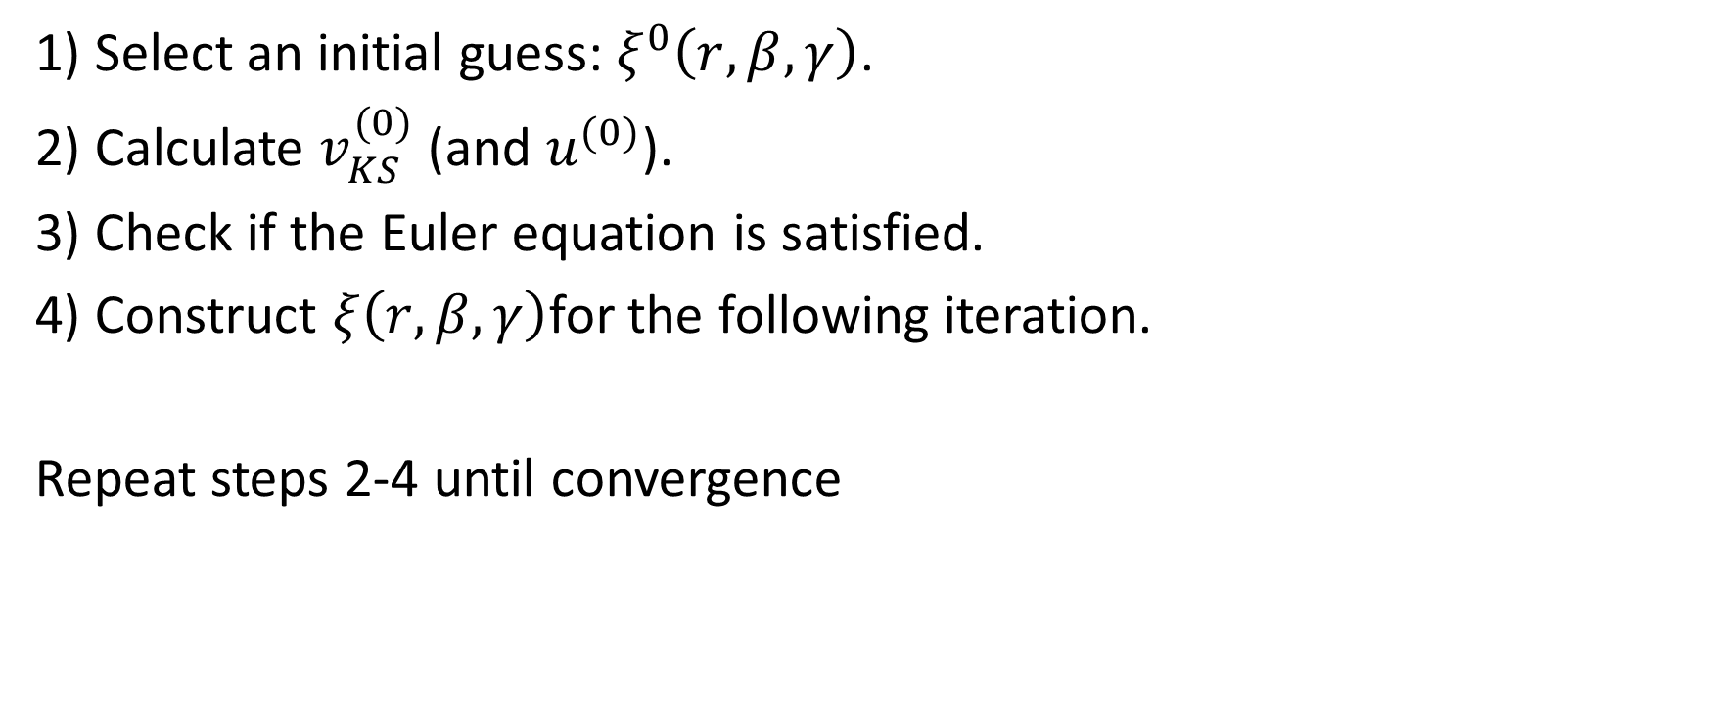
Solution of the orbital-free problem
1) Select an initial guess: $ξ^{0}\left(r,β,γ\right)$.
2) Calculate $v_{KS}^{(0)}$ (and $u^{(0)}$).
3) Check if the Euler equation is satisfied.
4) Construct $ξ\left(r,β,γ\right)$for the following iteration.
Repeat steps 2-4 until convergence

Slide 22

Numerical method of the solution
- exponential bin density - radial initial point ${10}^{−7}$ - Integration and derivation with variable allocation - approximation at r = 0, cusp

Slide 23
Numerical method of the solution
- modified Bulirsch-Stoer algorithm - differentiation by interpolation - fourth-order Runge-Kutta - comparison with KS solutions

Slide 24
Summary
Coulomb systems have the very special property that not only the ground-state electron density determines all their properties. There are several other quantities that are also capable of fully determining every property of a Coulomb system.
Though these descriptors have been known and studied for a while, equations for their calculations have not been presented yet.
To fill this gap, Euler equations for a family of descriptors of the spherically symmetric Coulomb systems are derived and discussed. These can be considered the generalizations of the Euler equation of the density functional theory.

